Slide 1
Chapter 13.2 - software product quality
SOFTWARE
PROJECT MANAGEMENT

Slide 2
BS EN ISO 9001:2000 and quality management systems
ISO 9001 is one of a family of standards that specify the characteristics of a good quality management system (QMS)
Can be applied to the creation of any type of product or service, not just IT and software
Does NOT set universal product/service standards
DOES specify the way in which standards are established and monitored
Notes:
Topics covered
Professional software development
What is meant by software engineering.
Software engineering ethics
A brief introduction to ethical issues that affect software engineering.
Suggested student projects
A brief introduction to each suggested project that can be carried out by students for this course

Slide 3
ISO 9001:2000 principles
Understanding the requirements of the customer
Leadership to provide unity of purpose and direction to achieve quality
Involvement of staff at all levels
Focus on the individual which create intermediate and deliverable products and services
Notes:
Topics covered
Professional software development
What is meant by software engineering.
Software engineering ethics
A brief introduction to ethical issues that affect software engineering.
Suggested student projects
A brief introduction to each suggested project that can be carried out by students for this course

Slide 4
ISO 9001:2000 principles
Focus on interrelation of processes that deliver products and services
Continuous process improvement
Decision-making based on factual evidence
Mutually beneficial relationships with suppliers
4
Notes:
Topics covered
Professional software development
What is meant by software engineering.
Software engineering ethics
A brief introduction to ethical issues that affect software engineering.
Suggested student projects
A brief introduction to each suggested project that can be carried out by students for this course

Slide 5
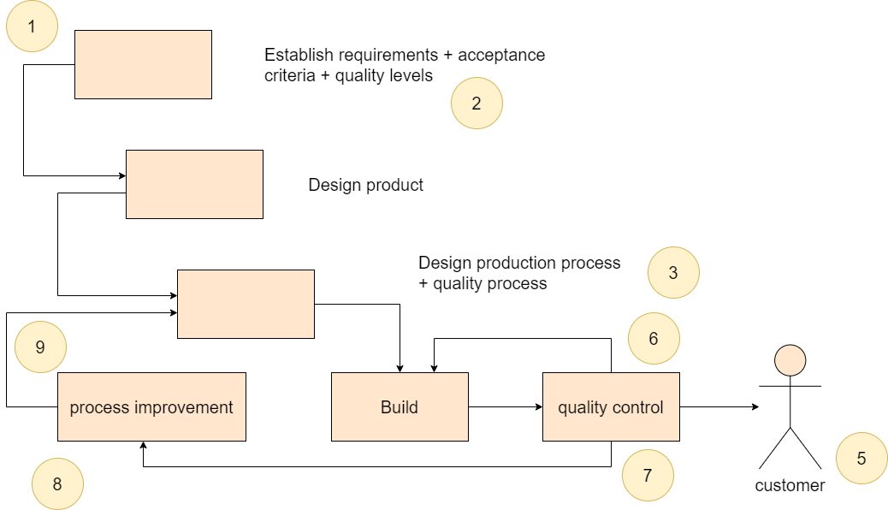
ISO 9001:2000 cycle
Notes:
Topics covered
Professional software development
What is meant by software engineering.
Software engineering ethics
A brief introduction to ethical issues that affect software engineering.
Suggested student projects
A brief introduction to each suggested project that can be carried out by students for this course

Slide 6
The need to improve
can everything be improved at one? no, must tackle the most important things first
‘poor companies are poor at changing’ some later improvements build on earlier ones
but there are problems
  improvement takes up time and money
  ‘improvement’ may simply be more bureaucracy!
Notes:
Topics covered
Professional software development
What is meant by software engineering.
Software engineering ethics
A brief introduction to ethical issues that affect software engineering.
Suggested student projects
A brief introduction to each suggested project that can be carried out by students for this course

Slide 7
Capability maturity model
created by Software Engineering Institute, Carnegie Mellon University
CMM developed by SEI for US government to help procurement
Watts S. Humphrey ‘Managing the software process’ Addison Wesley
Assessment is by questionnaire and interview
Notes:
Topics covered
Professional software development
What is meant by software engineering.
Software engineering ethics
A brief introduction to ethical issues that affect software engineering.
Suggested student projects
A brief introduction to each suggested project that can be carried out by students for this course

Slide 8
Capability maturity model 2
Different versions have been developed for different environments e.g. software engineering
New version CMMI tries to set up a generic model which can be populated differently for different environments
Notes:
Topics covered
Professional software development
What is meant by software engineering.
Software engineering ethics
A brief introduction to ethical issues that affect software engineering.
Suggested student projects
A brief introduction to each suggested project that can be carried out by students for this course

Slide 9
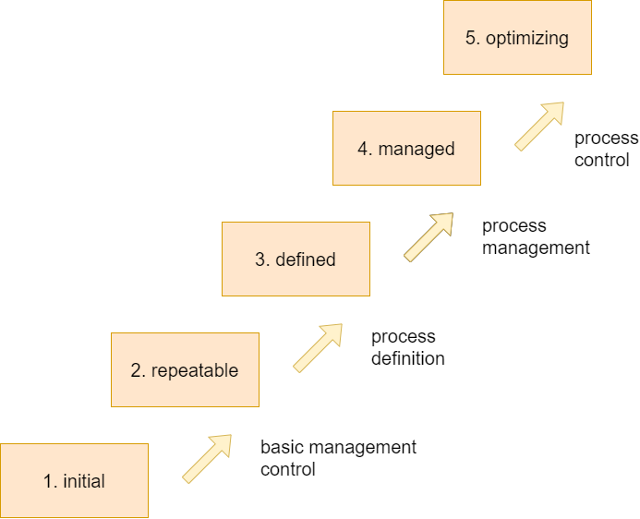
Process maturity levels
A company is at level 1 by default i.e. there is no level zero
Notes:
Topics covered
Professional software development
What is meant by software engineering.
Software engineering ethics
A brief introduction to ethical issues that affect software engineering.
Suggested student projects
A brief introduction to each suggested project that can be carried out by students for this course

Slide 10
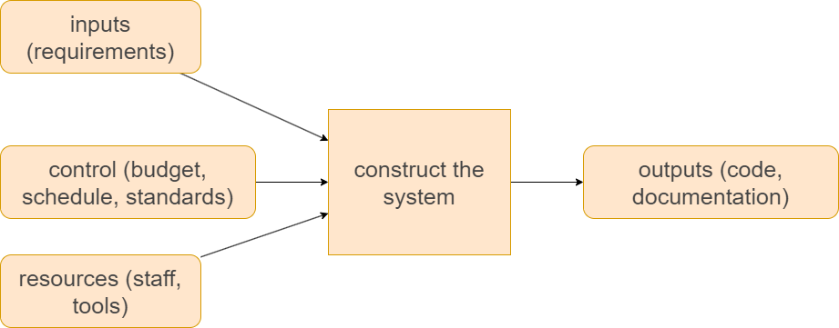
A repeatable model
Notes:
Topics covered
Professional software development
What is meant by software engineering.
Software engineering ethics
A brief introduction to ethical issues that affect software engineering.
Suggested student projects
A brief introduction to each suggested project that can be carried out by students for this course

Slide 11
Repeatable model KPAs
To move to this level concentrate on:
Configuration management
Quality assurance
Sub-contract management
Project planning
Project tracking and oversight
Measurement and analysis
Notes:
Topics covered
Professional software development
What is meant by software engineering.
Software engineering ethics
A brief introduction to ethical issues that affect software engineering.
Suggested student projects
A brief introduction to each suggested project that can be carried out by students for this course

Slide 12
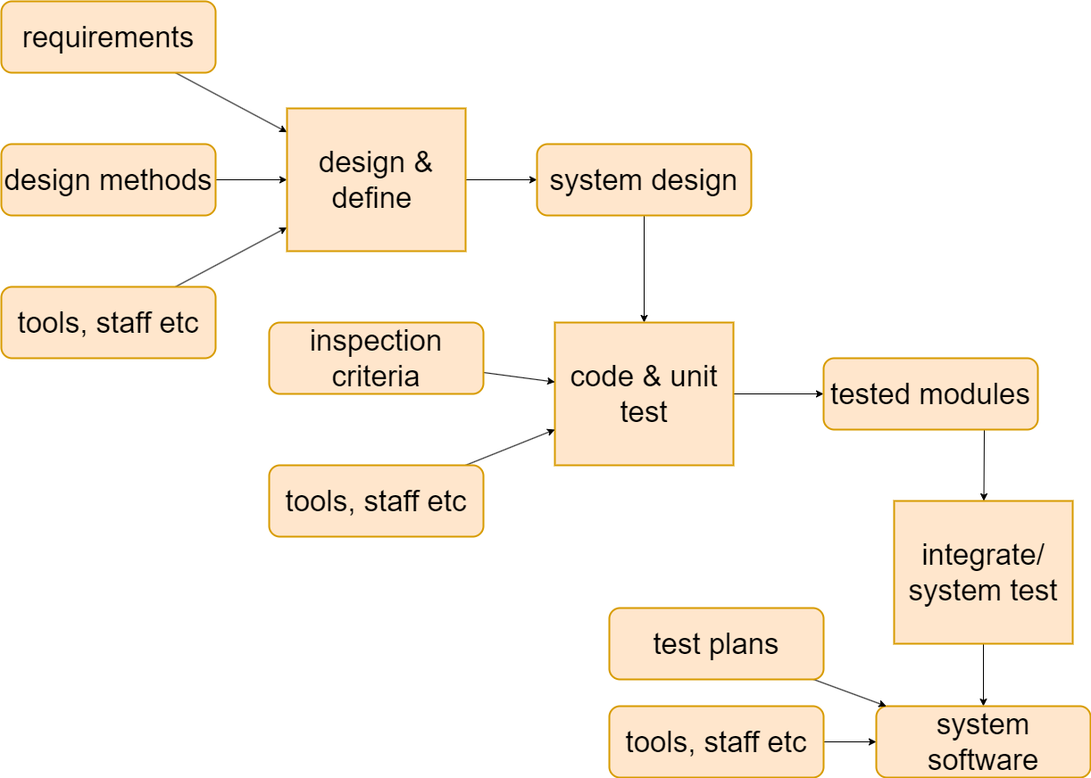
A defined process
Notes:
Topics covered
Professional software development
What is meant by software engineering.
Software engineering ethics
A brief introduction to ethical issues that affect software engineering.
Suggested student projects
A brief introduction to each suggested project that can be carried out by students for this course

Slide 13
Repeatable to defined KPAs
Concentrate on
Requirements development and technical solution
Verification and validation
Product integration
Risk management
Organizational training
Organizational process focus (function)
Decision analysis and resolution
Process definition Integrated project management
Notes:
Topics covered
Professional software development
What is meant by software engineering.
Software engineering ethics
A brief introduction to ethical issues that affect software engineering.
Suggested student projects
A brief introduction to each suggested project that can be carried out by students for this course

Slide 14
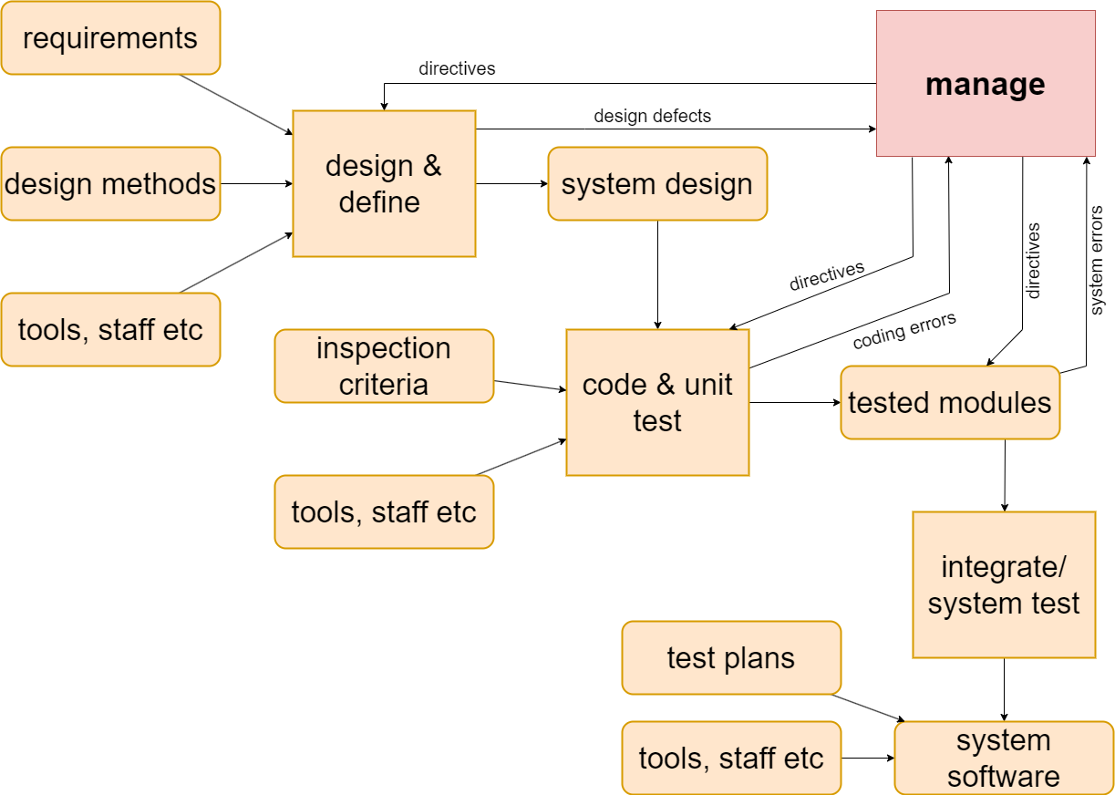
A managed process
Notes:
Topics covered
Professional software development
What is meant by software engineering.
Software engineering ethics
A brief introduction to ethical issues that affect software engineering.
Suggested student projects
A brief introduction to each suggested project that can be carried out by students for this course

Slide 15
Defined to managed KPAs
Concentrate on:
Organizational process performance
Quantitative project management
Notes:
Topics covered
Professional software development
What is meant by software engineering.
Software engineering ethics
A brief introduction to ethical issues that affect software engineering.
Suggested student projects
A brief introduction to each suggested project that can be carried out by students for this course

Slide 16
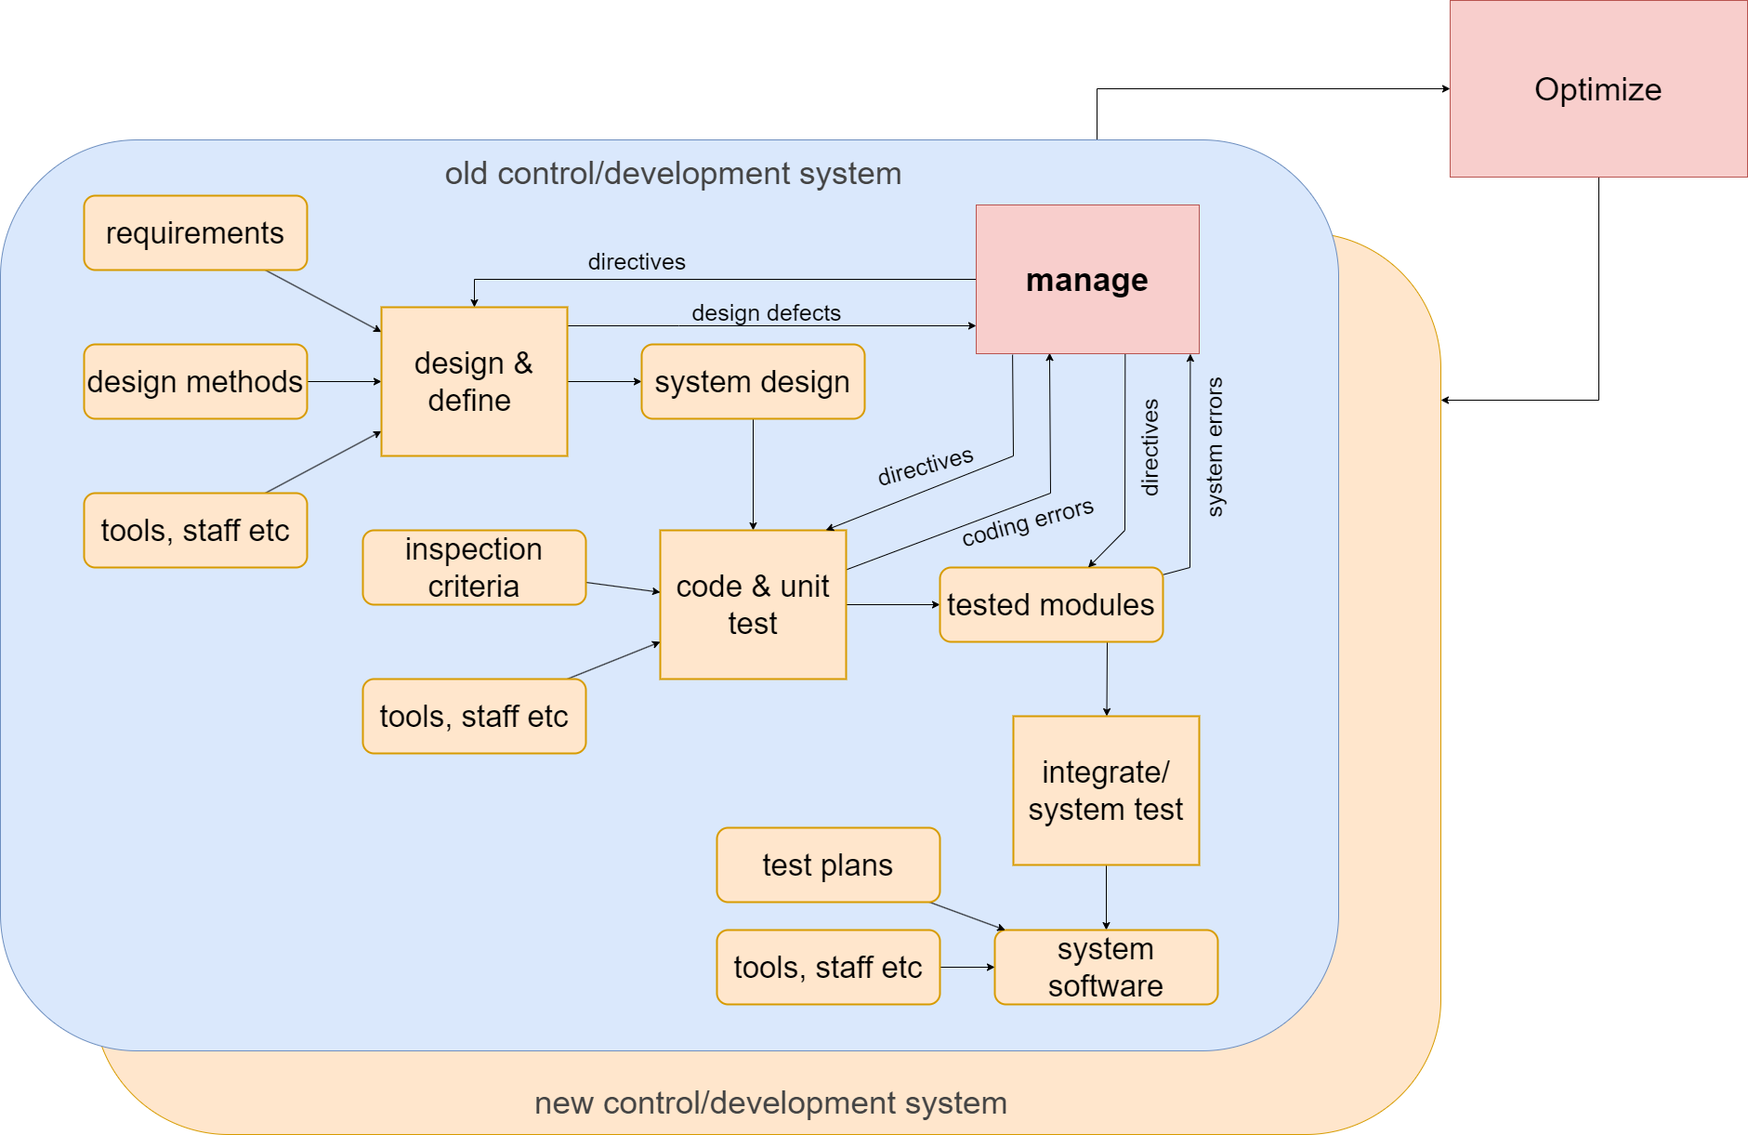
Optimizing
Notes:
Topics covered
Professional software development
What is meant by software engineering.
Software engineering ethics
A brief introduction to ethical issues that affect software engineering.
Suggested student projects
A brief introduction to each suggested project that can be carried out by students for this course

Slide 17
Managing to optimizing: KPAs
concentrate on:
Causal analysis and resolution
Organizational innovation and deployment
Notes:
Topics covered
Professional software development
What is meant by software engineering.
Software engineering ethics
A brief introduction to ethical issues that affect software engineering.
Suggested student projects
A brief introduction to each suggested project that can be carried out by students for this course

Slide 18
Some questions about CMMI
suitable only for large organizations?
  e.g. need for special quality assurance and process improvement groups
defining processes may not be easy with new technology
  how can we plan when we’ve not used the the development method before?
higher CMM levels easier with maintenance environments?
can you jump levels? (HP level 5 in India)
Notes:
Topics covered
Professional software development
What is meant by software engineering.
Software engineering ethics
A brief introduction to ethical issues that affect software engineering.
Suggested student projects
A brief introduction to each suggested project that can be carried out by students for this course

Slide 19
ISO/IEC 15504 IT process assessment
To provide guidance on the assessment of software development processes
Process Reference Model: Needs a defined set of processes that represent good practice to be the benchmark
ISO 12207 is the default reference model
Could use others in specific environments
Notes:
Topics covered
Professional software development
What is meant by software engineering.
Software engineering ethics
A brief introduction to ethical issues that affect software engineering.
Suggested student projects
A brief introduction to each suggested project that can be carried out by students for this course

Slide 20
ISO 15504 performance attributes
CMMI level | ISO 15504
 | 0 incomplete
Initial | 1.1 Process performance – achieves defined outcome
Repeatable | 2.1 Process management – it is planned and monitored
 | 2.2 Work product management – control of work products
Notes:
Topics covered
Professional software development
What is meant by software engineering.
Software engineering ethics
A brief introduction to ethical issues that affect software engineering.
Suggested student projects
A brief introduction to each suggested project that can be carried out by students for this course

Slide 21
ISO 15504 performance attributes - contd
CMMI level | ISO 15504
Defined | 3.1 Process definition
 | 3.2 Process deployment
Managed | 4.1 Process measurement
 | 4.2 Process control
Optimizing | 5.1 Process innovation
 | 5.2 Process optimization
Notes:
Topics covered
Professional software development
What is meant by software engineering.
Software engineering ethics
A brief introduction to ethical issues that affect software engineering.
Suggested student projects
A brief introduction to each suggested project that can be carried out by students for this course

Slide 22
Process Reference Model
A defined standard approach to development
Reflects recognized good practice
A benchmark against which the processes to be assessed can be judged
ISO 12207 is the default model
Notes:
Topics covered
Professional software development
What is meant by software engineering.
Software engineering ethics
A brief introduction to ethical issues that affect software engineering.
Suggested student projects
A brief introduction to each suggested project that can be carried out by students for this course

Slide 23
IS0 15504 Process Assessment
For each process in the relevant Process Reference Model
  For each set of attribute level criteria
    Assess whether:
      N: not achieved 0-15%
      P: partially achieved >15%-50%
      L: largely achieved >50%-85%
      F: fully achieved >85%
Notes:
Topics covered
Professional software development
What is meant by software engineering.
Software engineering ethics
A brief introduction to ethical issues that affect software engineering.
Suggested student projects
A brief introduction to each suggested project that can be carried out by students for this course

Slide 24
ISO 15504 performance indicators
This is just an example of how indicators for each level might be identified
1. Performance
Descriptions of maximum and minimum expected input values exist
2.1 Performance management
A plan of how expected input variable ranges are to be obtained exists which is up to date
Notes:
Topics covered
Professional software development
What is meant by software engineering.
Software engineering ethics
A brief introduction to ethical issues that affect software engineering.
Suggested student projects
A brief introduction to each suggested project that can be carried out by students for this course

Slide 25
ISO 15504 performance indicators 2
2.2 Work product management
There are minutes of a meeting where the input requirements document was reviewed and corrections were mandated
3.1 Process definition
A written procedure for input requirements gathering exists
3.2 Process deployment
A control document exists that is signed as each part of the procedure is completed
Notes:
Topics covered
Professional software development
What is meant by software engineering.
Software engineering ethics
A brief introduction to ethical issues that affect software engineering.
Suggested student projects
A brief introduction to each suggested project that can be carried out by students for this course

Slide 26
ISO 15504 performance indicators 2
4.1. Process measurement
Collected measurement data can be collected e.g. number of changes resulting from review
4.2. Process control
Memos relating to management actions taken in the light of the above
Notes:
Topics covered
Professional software development
What is meant by software engineering.
Software engineering ethics
A brief introduction to ethical issues that affect software engineering.
Suggested student projects
A brief introduction to each suggested project that can be carried out by students for this course

Slide 27
ISO 15504 performance indicators 3
5.1 Process innovation
Existence of some kind of ‘lessons learnt’ report at the end of project
5.2. Process optimization
Existence of documents assessing the feasibility of suggested process improvements and which show consultation with relevant stakeholders
Notes:
Topics covered
Professional software development
What is meant by software engineering.
Software engineering ethics
A brief introduction to ethical issues that affect software engineering.
Suggested student projects
A brief introduction to each suggested project that can be carried out by students for this course

Slide 28
Techniques to improve quality -Inspections
When a piece of work is completed, copies are distributed to co-workers
Time is spent individually going through the work noting defects
A meeting is held where the work is then discussed
A list of defects requiring re-work is produced
Notes:
Topics covered
Professional software development
What is meant by software engineering.
Software engineering ethics
A brief introduction to ethical issues that affect software engineering.
Suggested student projects
A brief introduction to each suggested project that can be carried out by students for this course

Slide 29
Inspections - advantages of approach
an effective way of removing superficial errors from a piece of software
motivates the software developer to produce better structured and self-descriptive code
spreads good programming practice
enhances team-spirit
the main problem maintaining the commitment of participants
Notes:
Topics covered
Professional software development
What is meant by software engineering.
Software engineering ethics
A brief introduction to ethical issues that affect software engineering.
Suggested student projects
A brief introduction to each suggested project that can be carried out by students for this course

Slide 30
‘Clean-room’ software development
Ideas associated with Harlan Mills at IBM
Three separate teams:
  Specification team – documents user requirements and usage profiles (how much use each function will have)
  Development team – develops code but does not test it. Uses mathematical verification techniques
  Certification team – tests code. Statistical model used to decide when to stop
Notes:
Topics covered
Professional software development
What is meant by software engineering.
Software engineering ethics
A brief introduction to ethical issues that affect software engineering.
Suggested student projects
A brief introduction to each suggested project that can be carried out by students for this course

Slide 31
Formal methods
Use of mathematical notations such as VDM and Z to produce unambiguous specifications
Can prove correctness of software mathematically (cf. geometric proofs of Pythagoras’ theorem)
Newer approach use Object Constraint Language (OCL) to add detail to UML models
Aspiration is to be able to generate applications directly from UML+OCL without manual coding – Model Driven Architectures (MDA)
Notes:
Topics covered
Professional software development
What is meant by software engineering.
Software engineering ethics
A brief introduction to ethical issues that affect software engineering.
Suggested student projects
A brief introduction to each suggested project that can be carried out by students for this course

Slide 32
Testing: the V-process model
This shown diagrammatically on the next slide
It is an extension of the waterfall approach
For each development stage there is a testing stage
The testing associated with different stages serves different purposes e.g. system testing tests that components work together correctly, user acceptance testing that users can use system to carry out their work
Notes:
Topics covered
Professional software development
What is meant by software engineering.
Software engineering ethics
A brief introduction to ethical issues that affect software engineering.
Suggested student projects
A brief introduction to each suggested project that can be carried out by students for this course

Slide 33
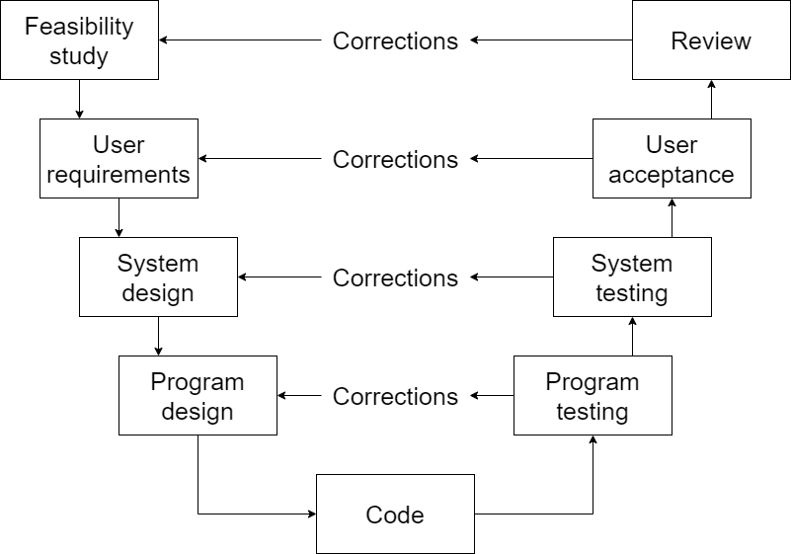
Testing: the v-process model
Notes:
Topics covered
Professional software development
What is meant by software engineering.
Software engineering ethics
A brief introduction to ethical issues that affect software engineering.
Suggested student projects
A brief introduction to each suggested project that can be carried out by students for this course

Slide 34
Black box versus glass box test
Glass box testing
  The tester is aware of the internal structure of the code; can test each path; can assess percentage test coverage of the tests e.g. proportion of code that has been executed
Black box testing
  The tester is not aware of internal structure; concerned with degree to which it meets user requirements
Notes:
Topics covered
Professional software development
What is meant by software engineering.
Software engineering ethics
A brief introduction to ethical issues that affect software engineering.
Suggested student projects
A brief introduction to each suggested project that can be carried out by students for this course

Slide 35
Test plans
Specify test environment
  In many cases, especially with software that controls equipment, a special test system will need to be set up
Usage profile
  Failures in operational system more likely in the more heavily used components
  Faults in less used parts can lie hidden for a long time
  Testing heavily used components more thoroughly tends to reduce number of operational failures
Notes:
Topics covered
Professional software development
What is meant by software engineering.
Software engineering ethics
A brief introduction to ethical issues that affect software engineering.
Suggested student projects
A brief introduction to each suggested project that can be carried out by students for this course

Slide 36
Management of testing
The tester executes test cases and may as a result find discrepancies between actual results and expected results – issues
Issue resolution – could be:
a mistake by tester
a fault – needs correction
a fault – may decide not to correct: off-specification
a change – software works as specified, but specification wrong: submit to change control
Notes:
Topics covered
Professional software development
What is meant by software engineering.
Software engineering ethics
A brief introduction to ethical issues that affect software engineering.
Suggested student projects
A brief introduction to each suggested project that can be carried out by students for this course

Slide 37
Decision to stop testing
The problem: impossible to know there are no more errors in code
Need to estimate how many errors are likely to be left
Bug seeding – insert (or leave) known bugs in code
Estimate of bugs left = (total errors found)/(seeded errors found) x (total seeded errors)
Notes:
Topics covered
Professional software development
What is meant by software engineering.
Software engineering ethics
A brief introduction to ethical issues that affect software engineering.
Suggested student projects
A brief introduction to each suggested project that can be carried out by students for this course

Slide 38
Alternative method of error estimation
Have two independent testers, A and B
N1 = valid errors found by A
N2 = valid errors found by B
N12 = number of cases where same error found by A and B
Estimate = (N1 × N2 )/ N12
Example: A finds 30 errors, B finds 20 errors. 15 are common to A and B. How many errors are there likely to be?
Notes:
Topics covered
Professional software development
What is meant by software engineering.
Software engineering ethics
A brief introduction to ethical issues that affect software engineering.
Suggested student projects
A brief introduction to each suggested project that can be carried out by students for this course

Slide 39
Quality plans
Quality standards and procedures should be documented in an organization’s quality manual
For each separate project, the quality needs should be assessed
Select the level of quality assurance needed for the project and document in a quality plan
Notes:
Topics covered
Professional software development
What is meant by software engineering.
Software engineering ethics
A brief introduction to ethical issues that affect software engineering.
Suggested student projects
A brief introduction to each suggested project that can be carried out by students for this course

Slide 40
typical contents of a quality
Plan scope of plan
References to other documents
Quality management, including organization, tasks, and responsibilities
Documentation to be produced
Standards, practices and conventions
Reviews and audits
Notes:
Topics covered
Professional software development
What is meant by software engineering.
Software engineering ethics
A brief introduction to ethical issues that affect software engineering.
Suggested student projects
A brief introduction to each suggested project that can be carried out by students for this course

Slide 41
more contents of a quality plan
testing
problem reporting and corrective action
tools, techniques, and methodologies
code, media and supplier control
records collection, maintenance and retention
training
risk management
Notes:
Topics covered
Professional software development
What is meant by software engineering.
Software engineering ethics
A brief introduction to ethical issues that affect software engineering.
Suggested student projects
A brief introduction to each suggested project that can be carried out by students for this course

